Slide 1
UPPER SIXTH ARTS
GEOGRAPHY
Lesson 2
Deforestation and Desertification
Notes:
Good morning, class, and welcome to our geography lesson. I am your geography teacher, Mr Kamdem. Today we are starting Lesson 2: Deforestation and Desertification.

Slide 2
CLASS INFO
Class, Chapter and Duration
Class | Upper Sixth Arts
Chapter | Module 7: Understanding and managing contemporary environmental and development issues
Duration | 2 periods (2 × 50 minutes)
Notes:
This lesson is for Upper Sixth Arts. It belongs to Module 7: Understanding and managing contemporary environmental and development issues. We shall need 2 periods to cover it.

Slide 3
IDENTIFICATION
Lesson Identification
Topic | Contemporary Environmental Issues
Sub-topic | Environmental Degradation
Lesson | Lesson 2: Deforestation and Desertification
Notions / Concepts | Deforestation, desertification, overgrazing, afforestation, reforestation, Green Wall.
Syllabus focus | Meaning and examples; causes; consequences; preventive and corrective measures.
Competence | Learners are able to explain the causes and consequences of deforestation and desertification and propose measures.
Notes:
Our topic is Contemporary Environmental Issues, and the sub-topic is Environmental Degradation. The key notions we shall use today are: deforestation, desertification, overgrazing, afforestation, reforestation, Green Wall. At the end, you should be able to do this: learners are able to explain the causes and consequences of deforestation and desertification and propose measures.

Slide 4

HOMEWORK CORRECTION
Correction of the Homework
Question (Lesson 1: Pollution):
List the sources of pollution around your home and suggest one solution for each.
Notes:
Before we start the new lesson, let us correct the homework I gave you at the end of Lesson 1: Pollution. The question was: List the sources of pollution around your home and suggest one solution for each. Take out your exercise books.

Slide 5
HOMEWORK CORRECTION
Correction: Possible Answer
Examples: burning rubbish (solution: collect and compost or recycle it); smoke from old cars (service engines); plastic bags in gutters (reuse or collect them); latrines near wells (build them far from and below the well).
Notes:
Here is a good answer. Examples: burning rubbish (solution: collect and compost or recycle it); smoke from old cars (service engines); plastic bags in gutters (reuse or collect them); latrines near wells (build them far from and below the well). Compare it with your own answer and correct your work in red.

Slide 6
LESSON PLAN
Lesson Plan
Correction of the homework
Objectives and recall
Real-life situation and action to take
Learning activities
Board summary
Evaluation, remediation and homework
Notes:
Here is the plan of our lesson today. First, we shall correct the homework. Then we shall look at the objectives and recall what you already know. After that, we shall study a situation from real life and the action to take, and do the learning activities. Finally, we shall copy the board summary, do the evaluation and the remediation, and I will give you the homework.

Slide 7
OBJECTIVES
Objectives
By the end of this lesson, you should be able to:
Define deforestation and desertification with examples.
Explain their causes and consequences.
Notes:
Take your time to copy this part; we will continue together.

Slide 8
OBJECTIVES
Objectives (continued)
Propose preventive and corrective measures.
Notes:
By the end of this lesson, you should be able to do three things. Number 1: define deforestation and desertification with examples. Number 2: explain their causes and consequences. Number 3: propose preventive and corrective measures.

Slide 9
PREVIOUS KNOWLEDGE
Previous Knowledge
Trees protect the soil.
The Far North of Cameroon is close to the Sahara.
Notes:
Let us first remember what you already know. Trees protect the soil. The Far North of Cameroon is close to the Sahara. Keep this in mind, because we shall build on it today.

Slide 10
REAL-LIFE SITUATION
Situation in Real Life
In the East Region, large areas of forest are cut for timber and farms. In the Far North, trees are cut for firewood, cattle eat all the grass and sand begins to cover fields.
Notes:
Listen carefully to this situation from real life. In the East Region, large areas of forest are cut for timber and farms. In the Far North, trees are cut for firewood, cattle eat all the grass and sand begins to cover fields. Think about it, because I am going to ask you some questions.

Slide 11
REAL-LIFE SITUATION
Situation: Question 1
What is the problem in the situation?
Notes:
Question 1: What is the problem in the situation? Think for a moment, then raise your hand to answer.

Slide 12
REAL-LIFE SITUATION
Answer
Forests are destroyed and land is becoming desert.
Notes:
Good. Forests are destroyed and land is becoming desert.

Slide 13
REAL-LIFE SITUATION
Situation: Question 2
What is the loss of forest called?
Notes:
Question 2: What is the loss of forest called? Think for a moment, then raise your hand to answer.

Slide 14
REAL-LIFE SITUATION
Answer
Deforestation.
Notes:
Good. Deforestation.

Slide 15
REAL-LIFE SITUATION
Situation: Question 3
What is the spread of desert conditions called?
Notes:
Question 3: What is the spread of desert conditions called? Think for a moment, then raise your hand to answer.

Slide 16
REAL-LIFE SITUATION
Possible Answer
Desertification.
Notes:
Good. Desertification.

Slide 17
ACTION TO TAKE
Action to Take
Plant trees and use improved stoves to save wood.
Notes:
From this situation, the action we are working towards in this lesson is the following: plant trees and use improved stoves to save wood.

Slide 18
JUSTIFICATION
Justification of the Lesson
This lesson helps us to protect forests and fight desertification.
Notes:
Why is this lesson important for you? This lesson helps us to protect forests and fight desertification.

Slide 19

1. MEANING OF DEFORESTATION
Activity 1
A forest cleared by logging.
Notes:
Activity 1. Look carefully at this picture: a forest cleared by logging. Observe every detail before I ask the question.

Slide 20
1. MEANING OF DEFORESTATION
Activity 1: Question
What is deforestation?
Notes:
Here is the question for Activity 1: What is deforestation? Take one minute to think and write your answer in your rough notebook.

Slide 21
1. MEANING OF DEFORESTATION
Activity 1: Answer
The removal of forests for timber, farming or building.
Notes:
Let us check the answer together. The removal of forests for timber, farming or building.

Slide 22
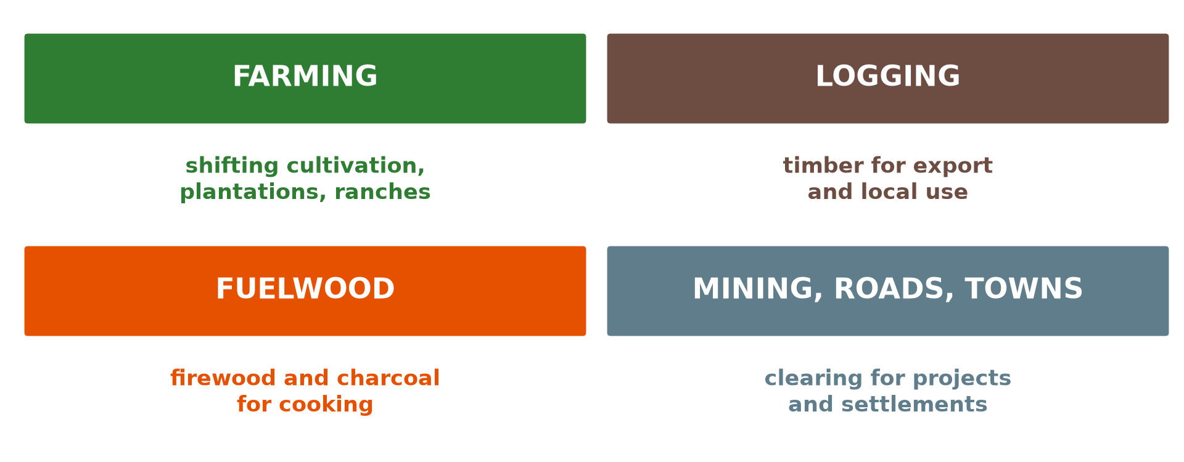
1. CAUSES OF DEFORESTATION
Activity 2
Causes of deforestation.
Notes:
Activity 2. Look carefully at this diagram: causes of deforestation. Observe every detail before I ask the question.

Slide 23
1. CAUSES OF DEFORESTATION
Activity 2: Question
Give three causes of deforestation.
Notes:
Here is the question for Activity 2: Give three causes of deforestation. Take one minute to think and write your answer in your rough notebook.

Slide 24
1. CAUSES OF DEFORESTATION
Activity 2: Answer
Farming, logging and fuelwood (also mining and roads).
Notes:
Let us check the answer together. Farming, logging and fuelwood (also mining and roads).

Slide 25
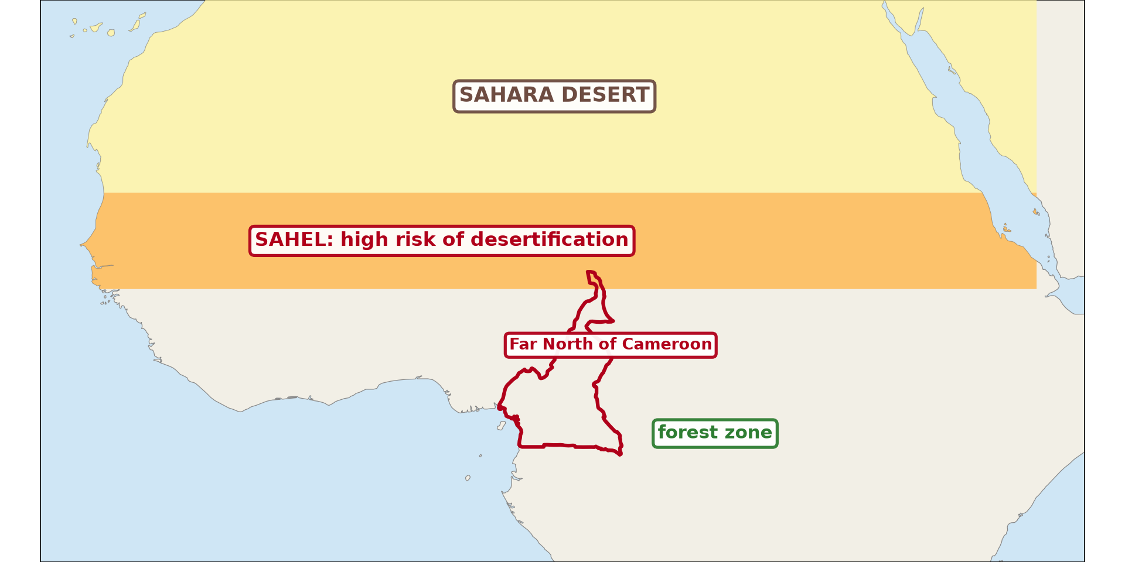
2. DESERTIFICATION
Activity 3
The Sahel, at risk of desertification.
Notes:
Activity 3. Look carefully at this diagram: the Sahel, at risk of desertification. Observe every detail before I ask the question.

Slide 26
2. DESERTIFICATION
Activity 3: Question
Where is desertification most serious in Africa?
Notes:
Here is the question for Activity 3: Where is desertification most serious in Africa? Take one minute to think and write your answer in your rough notebook.

Slide 27
2. DESERTIFICATION
Activity 3: Answer
In the Sahel, south of the Sahara, including the Far North of Cameroon.
Notes:
Let us check the answer together. In the Sahel, south of the Sahara, including the Far North of Cameroon.

Slide 28
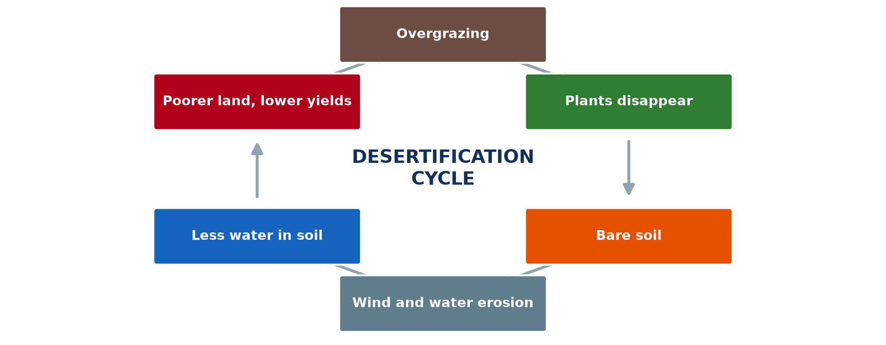
2. CAUSES OF DESERTIFICATION
Activity 4
The desertification cycle.
Notes:
Activity 4. Look carefully at this diagram: the desertification cycle. Observe every detail before I ask the question.

Slide 29
2. CAUSES OF DESERTIFICATION
Activity 4: Question
How does overgrazing lead to desertification?
Notes:
Here is the question for Activity 4: How does overgrazing lead to desertification? Take one minute to think and write your answer in your rough notebook.

Slide 30
2. CAUSES OF DESERTIFICATION
Activity 4: Answer
Animals remove plants, the soil is bare and is eroded by wind and water.
Notes:
Let us check the answer together. Animals remove plants, the soil is bare and is eroded by wind and water.

Slide 31

3. MEASURES
Activity 5
Planting trees in the Sahel.
Notes:
Activity 5. Look carefully at this picture: planting trees in the Sahel. Observe every detail before I ask the question.

Slide 32
3. MEASURES
Activity 5: Question
Give two measures against desertification.
Notes:
Here is the question for Activity 5: Give two measures against desertification. Take one minute to think and write your answer in your rough notebook.

Slide 33
3. MEASURES
Activity 5: Answer
Tree planting (Green Wall, Sahel Vert) and controlled grazing (also improved stoves).
Notes:
Let us check the answer together. Tree planting (Green Wall, Sahel Vert) and controlled grazing (also improved stoves).

Slide 34
BOARD SUMMARY
Board Summary
Topic: Contemporary Environmental Issues
Sub-topic: Environmental Degradation
Lesson 2: Deforestation and Desertification
Notes:
Now we are going to copy the board summary. Write the title and the headings neatly in your notebooks. I will give you enough time for each slide, so do not rush.

Slide 35
BOARD SUMMARY
DEFINITIONS
The key terms of this lesson are defined as follows:
Deforestation: It is the removal of forest cover by people. It is fast in the Amazon, the Congo Basin and South-East Asia.
Notes:
Let us copy the definitions. The key terms of this lesson are defined as follows. On this slide we have Deforestation. Write each point on a new line, with the key term first, and explain it in your own words when we revise. When you finish, we go to the next slide.

Slide 36
BOARD SUMMARY
DEFINITIONS (continued)
Desertification: It is the spread of desert conditions into semi-arid lands. It is serious in the Sahel, including the Far North of Cameroon.
Notes:
We continue with the definitions. On this slide we have Desertification. Write each point on a new line, with the key term first, and explain it in your own words when we revise.

Slide 37
BOARD SUMMARY
1. Causes and Consequences of Deforestation
Deforestation has the following causes and consequences:
Causes: Shifting cultivation, commercial logging, fuelwood, mining and road building remove forests. Rapid population growth increases the demand for land and wood.
Notes:
Let us copy Causes and Consequences of Deforestation. Deforestation has the following causes and consequences. On this slide we have Causes. Write each point on a new line, with the key term first, and explain it in your own words when we revise. When you finish, we go to the next slide.

Slide 38
BOARD SUMMARY
1. Causes and Consequences of Deforestation (continued)
Consequences: Deforestation causes soil erosion, loss of biodiversity and changes in local rainfall. It also releases carbon dioxide and so adds to global warming.
Notes:
We continue with Causes and Consequences of Deforestation. On this slide we have Consequences. Write each point on a new line, with the key term first, and explain it in your own words when we revise.

Slide 39
BOARD SUMMARY
1. Causes and Consequences of Deforestation
Illustration: causes of deforestation
Notes:
Now draw this illustration in your notebook: causes of deforestation. Give it a title and label it clearly.

Slide 40
BOARD SUMMARY
2. Causes and Consequences of Desertification
Desertification has the following causes and consequences:
Physical causes: Long droughts and high temperatures dry out the vegetation. Strong winds then remove the loose soil.
Notes:
Let us copy Causes and Consequences of Desertification. Desertification has the following causes and consequences. On this slide we have Physical causes. Write each point on a new line, with the key term first, and explain it in your own words when we revise. When you finish, we go to the next slide.

Slide 41
BOARD SUMMARY
2. Causes and Consequences of Desertification (continued)
Human causes: Overgrazing, overcultivation and cutting trees for fuel leave the soil bare. Bush fires and population pressure make the problem worse.
Consequences: Desertification reduces crops and pasture and causes famine. People migrate to towns or to wetter areas.
Notes:
We continue with Causes and Consequences of Desertification. On this slide we have Human causes and Consequences. Write each point on a new line, with the key term first, and explain it in your own words when we revise.

Slide 42
BOARD SUMMARY
2. Causes and Consequences of Desertification
Illustration: the desertification cycle
Notes:
Now draw this illustration in your notebook: the desertification cycle. Give it a title and label it clearly.

Slide 43
BOARD SUMMARY
3. Measures
The following measures fight deforestation and desertification:
Preventive measures: Controlled logging, protected areas and improved stoves reduce tree cutting. Controlled grazing protects pastures.
Notes:
Let us copy Measures. The following measures fight deforestation and desertification. On this slide we have Preventive measures. Write each point on a new line, with the key term first, and explain it in your own words when we revise. When you finish, we go to the next slide.

Slide 44
BOARD SUMMARY
3. Measures (continued)
Corrective measures: Reforestation and afforestation replace lost trees. The Great Green Wall project and the Sahel Vert operation plant trees across the Sahel.
Notes:
We continue with Measures. On this slide we have Corrective measures. Write each point on a new line, with the key term first, and explain it in your own words when we revise.

Slide 45
FORMATIVE EVALUATION
Evaluation 1
Define desertification and give two causes.
Notes:
Now let us check what you have understood. Question 1: Define desertification and give two causes. Answer in your exercise book.

Slide 46
FORMATIVE EVALUATION
Expected Answer
The spread of desert conditions; overgrazing and cutting trees.
Notes:
The expected answer is: the spread of desert conditions; overgrazing and cutting trees. If you got it right, well done.

Slide 47
FORMATIVE EVALUATION
Evaluation 2
Give two preventive and two corrective measures.
Notes:
Now let us check what you have understood. Question 2: Give two preventive and two corrective measures. Answer in your exercise book.

Slide 48
FORMATIVE EVALUATION
Expected Answer
Preventive: controlled grazing, improved stoves. Corrective: reforestation, stone lines.
Notes:
The expected answer is: preventive: controlled grazing, improved stoves. Corrective: reforestation, stone lines. If you got it right, well done.

Slide 49
REMEDIATION
Remediation
Fill in the blanks:
Removing forests is ______.
Too many animals on land is ______.
Planting trees again is ______.
Notes:
For those who need more practice, fill in the blanks in your exercise book. The answers are: number 1, deforestation; number 2, overgrazing; number 3, reforestation.

Slide 50
HOMEWORK
Homework
Interview an elder about changes in trees and grass in your area over the years.
Notes:
For your homework: Interview an elder about changes in trees and grass in your area over the years. We shall correct it at the beginning of our next lesson.

Slide 51
NEXT LESSON
Next Lesson
Our next lesson will be on:
Lesson 3: Soil Erosion
Notes:
Our next lesson will be on Lesson 3: Soil Erosion. Thank you for your attention, and see you next time.

Slide 52
BILINGUAL GAME
Bilingual Game (Jeu Bilingue)
English | Français
Deforestation | La déforestation
Desertification | La désertification
Overgrazing | Le surpâturage
Firewood | Le bois de chauffe
Tree planting | Le reboisement
Drought | La sécheresse
Notes:
Let us play the bilingual game. I say a word in English, and you give me the French word. Then we do the reverse.

Slide 53
LOGBOOK
Official Logbook (1/2)
Module / Topic | Contemporary Environmental Issues
Lesson Title | Lesson 2: Deforestation and Desertification
Expected Learning Outcomes | Define deforestation and desertification with examples. Explain their causes and consequences. Propose preventive and corrective measures.
Competence | Learners are able to explain the causes and consequences of deforestation and desertification and propose measures.
Notes:
I record this information in the official logbook of the class after the lesson.

Slide 54
LOGBOOK
Official Logbook (2/2)
Matter Taught | DEFINITIONS; Causes and Consequences of Deforestation; Causes and Consequences of Desertification; Measures.
Evaluation | Formative evaluation and remediation exercise.
Homework | Interview an elder about changes in trees and grass in your area over the years.
Enrolment / Present / Absent | ____ / ____ / ____
Achievement | To be completed after the lesson.
Notes:
I complete the second page of the logbook: the matter taught, the evaluation, the homework and the attendance.

Slide 55
TEACHER'S NOTE
Teacher's Note
Timing: Homework correction, plan, objectives 8 min | Recall, situation, action 10 min | 5 activities 30 min | Board summary (copying) 30 min | Evaluation, remediation 10 min | Homework, next lesson 5 min | Logbook 7 min
Without the projector (Activity 1): describe cut forests you know.
Without the projector (Activity 2): list causes in your region.
Without the projector (Activity 3): locate the Sahel.
Without the projector (Activity 4): follow the cycle.
Without the projector (Activity 5): discuss tree planting.
Notes:
This slide is for me, the teacher: it gives the timing of the lesson and what to do if the projector is not available.

Slide 56
REFERENCES
References
National Geography Syllabus, MINESEC/IGE/IP-SS, 2019 — Module 7 (Environment and Development).
Photo, Activity 1: “Managed Destruction” by Harlz_, CC BY-NC 2.0, via Flickr (https://www.flickr.com/photos/35169553@N06/4295797661)
Photo, Activity 5: “Nyando Climate Smart Villages Media Visit” by CGIAR Climate, CC BY-NC-SA 2.0, via Flickr (https://www.flickr.com/photos/55227776@N04/9720026817)
Diagrams and animations: drawn for this lesson (Geography Department).
Notes:
These are the references and picture credits used to prepare this lesson.

